Slide 1
Morse code translator
web application
By Frederick Wilson Jennings

Slide 2

What is morse code?
-Morse code is a character encoding scheme used in telecommunication that encodes text characters as standardized sequences of two different signal.
-The timing for morse code: 1 unit of time = dot, 3 units of time =dash , 7 units of time = space
-Can translate A to Z, 0 to 9 as well as some other special characters.
-Each word is made up of a sequence of dots and dashes based on the letters.

Slide 3
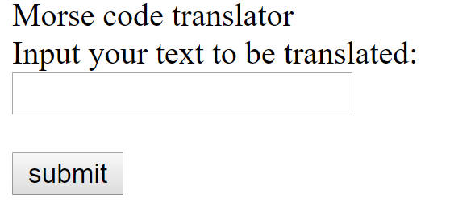
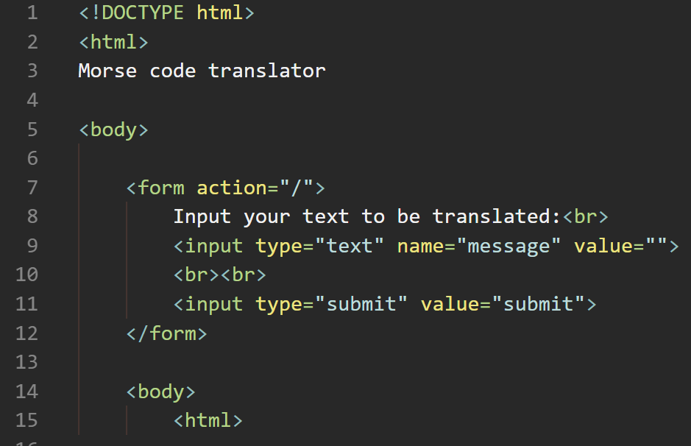
The front end of my website
Here using html i made a main page that has a title followed by a message asking you to write your text in the text box and to then click the submit button

Slide 4
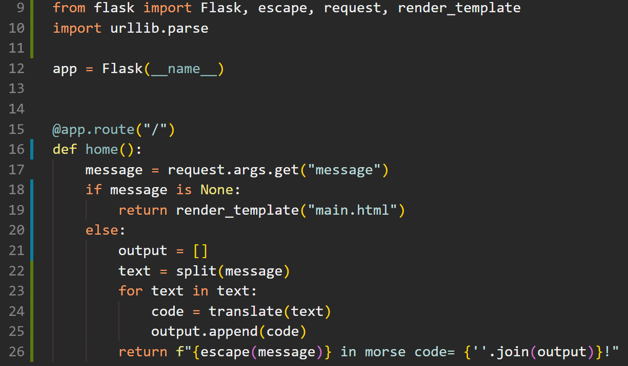
How my code interacts with the website
message = request.args.get("message")
Takes variable ‘message’ from the url.
return render_template("main.html")
Goes back to my home page.
return f"{escape(message)} in morse code= {''.join(output)}"
Prints my my text then says “in morse code=” then prints the the ‘output’ of my translator.

Slide 5
The translator code - main custom function
The name of my function is: def translate(text):
With this it will take ‘text’ and it will translate it based on the dictionary i made:
if text == "A":
morse = ".- "
elif text == "B":
morse = "-... "
elif text == "C":
morse = "-.-. "
return morse

Slide 6
Turning inputted words into a string- Custom function
The name of this function is def split(message):
It split ’message’ into an list of different letters.
return [char for char in message]
The return takes each character in message individually in order.
Why? So the code will run through each index (letter) individually in order of the indexing.
text = split(message)
for text in text:
code = translate(text)

Slide 7
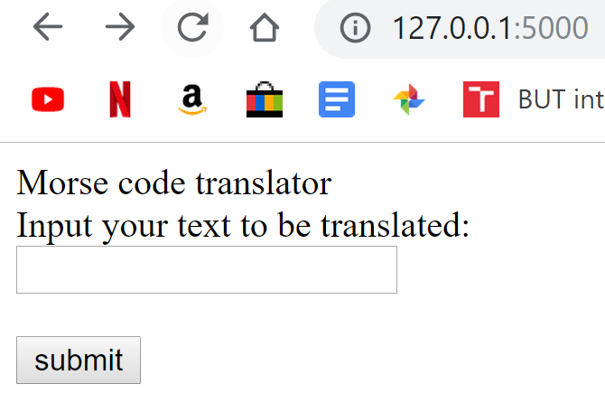
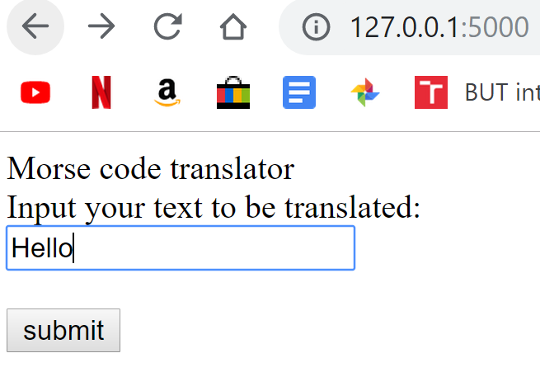
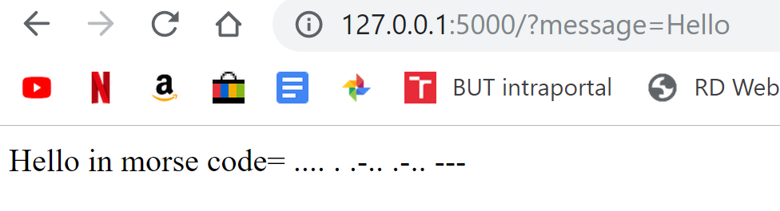
My web application procedure

Slide 8
Thank you for your attention
By Frederick Wilson Jennings

